Slide 1

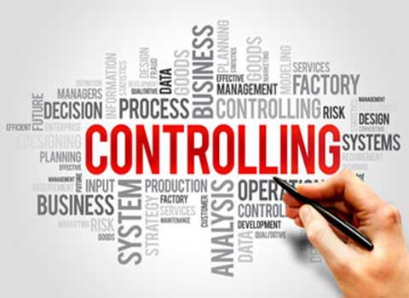
Unit 5

Slide 2

Controlling
According to Brech,
“Controlling is a systematic exercise which is called as a process of checking actual performance against the standards or plans with a view to ensure adequate progress and also recording such experience as is gained as a contribution to possible future needs.”

Slide 3

Features of Controlling
An effective control system has the following features:
It helps in achieving organizational goals.
Facilitates optimum utilization of resources.
It evaluates the accuracy of the standard.
It also sets discipline and order.
Motivates the employees and boosts employee morale.
Ensures future planning by revising standards.
Improves overall performance of an organization.
It also minimises errors.

Slide 4
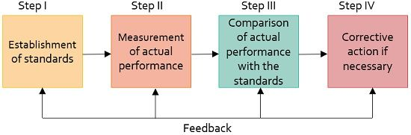
Process of Controlling

Slide 5
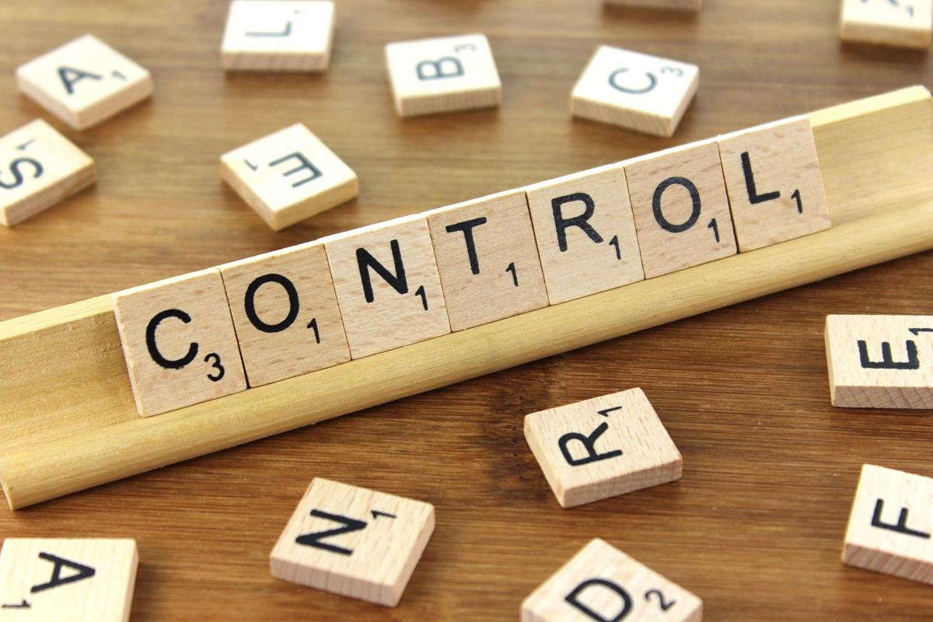
Types of Control
Feedback Control
Concurrent Control
Predictive/ Feedforward Control

Slide 6

Case Study
Mr. Nath, a recently appointed production manager of Suntech Ltd., has decided to produce jute bags instead of plastic bags as these are banned by the government. He set a target of producing 1000 jute bags a day. It was reported that the employees were not able to achieve the target. After analysis, he found that employees were demotivated and not putting in their best for achieving the target. Mr. Nath’s behaviour is good towards the employees. His attitude is always positive. So, he announced various incentive schemes for the employees like:
Installing awards or certificates for best performance
Rewarding an employee for giving valuable suggestions
Congratulating the employees for good performance

Slide 7

Questions
Identify the functions of management highlighted in the Case Study.
State the incentive under which the employee are motivated.
State any two values which the production manager wants to communicate to society by his work and behaviour.

Slide 8
METHODS OF CONTROL
Financial Controls
Budget Controls
Marketing Controls
Human Resource Controls
Computers And Information Controls

Slide 9
Financial Controls
Financial Statements
Financial Audits
Financial Ratio Analysis
  Liquidity ratios measure an organization's ability to generate cash.
  Profitability ratios measure an organization's ability to generate profits.
  Debt ratios measure an organization's ability to pay its debts.
  Activity ratios measure an organization's efficiency in operations and use of assets.

Slide 10
Budget Controls
Top-down budgeting.
Bottom-up budgeting
Flexible budgeting.
Zero-based budgeting

Slide 11
Marketing Controls
Market research
Test marketing
Marketing statistics

Slide 12

Human Resource Controls

Slide 13
Computers And Information Controls
Performance Limitations
Behavioral Limitations
Health Risks

Slide 14


Slide 15
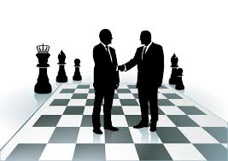
Strategic Management
As per Fred R. David,
“Strategic Management is an art and science of formulating, implementing and evaluating cross functional decisions that enable an organization to achieve its objectives.’

Slide 16
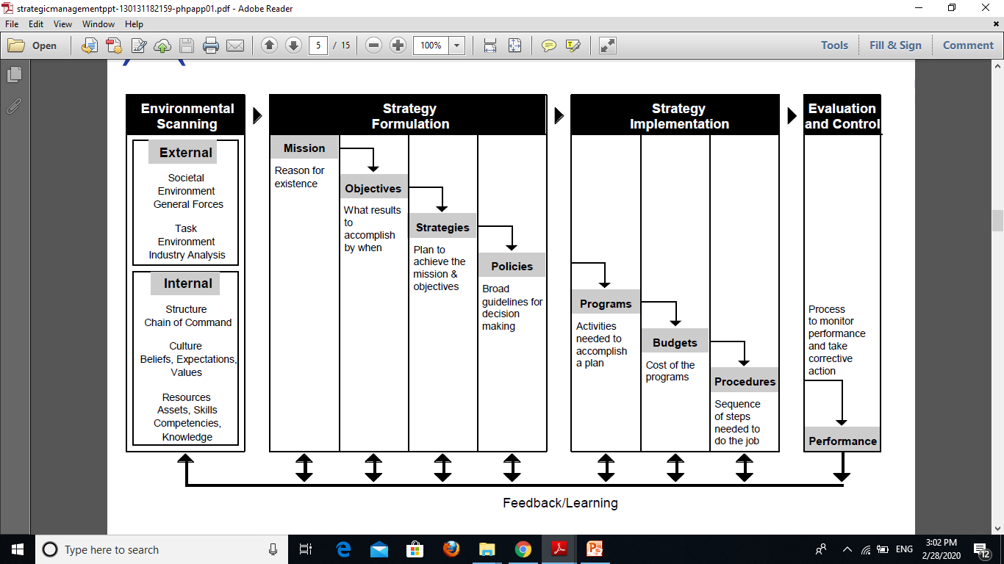
Strategic Management Process

Slide 17

Objective of Strategic Management
Competitive Advantage
Achieving Goals
Sustainable Growth
Cohesive Organization
Increased Managerial Awareness

